Slide 1
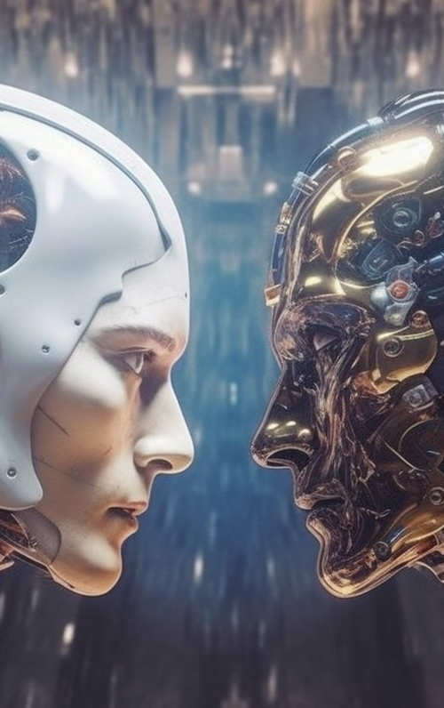
VectorDB and LLM
Semantic information retrieval, long-term memory, and more
Camilo Pestana
Image created with Midjourney:
“Large Language Models and Artificial Intelligence. Machines conversing with humans”

Slide 2
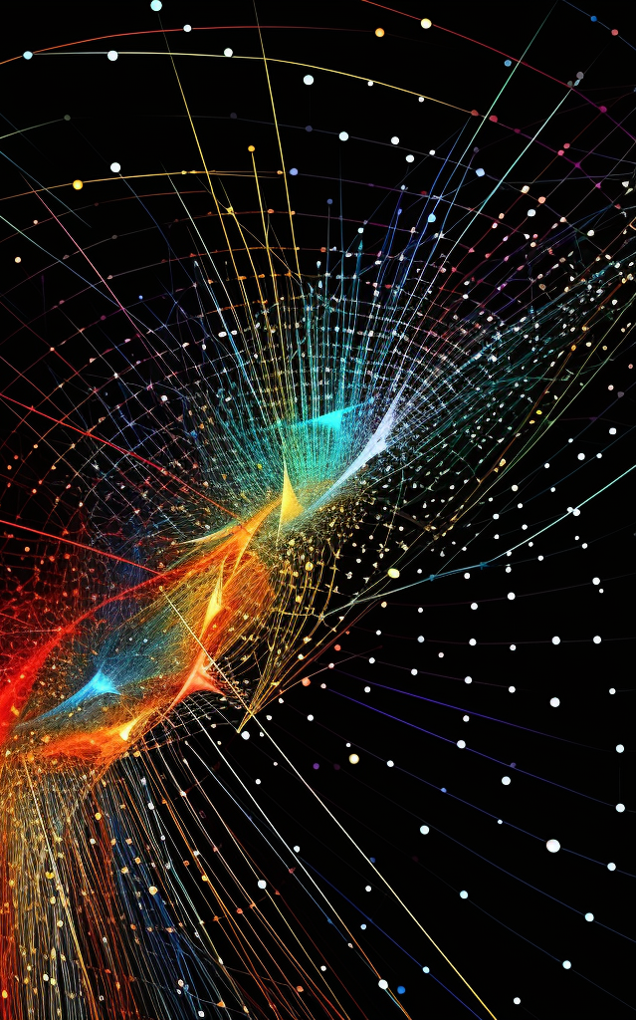
What’s a Vector Database?
“We’re in the midst of the AI revolution. It’s upending any industry it touches, promising great innovations - but it also introduces new challenges. Efficient data processing has become more crucial than ever for applications that involve large language models, generative AI, and semantic search.”
“All of these new applications rely on vector embeddings, a type of data representation that carries within it semantic information that’s critical for the AI to gain understanding and maintain a long-term memory they can draw upon when executing complex tasks.”
- Pinecone
Image created with Midjourney: “vectors in a hyperspace. similarity search and cosine similarity”

Slide 3

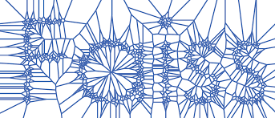


VectorDBs and Search Engines

Slide 4
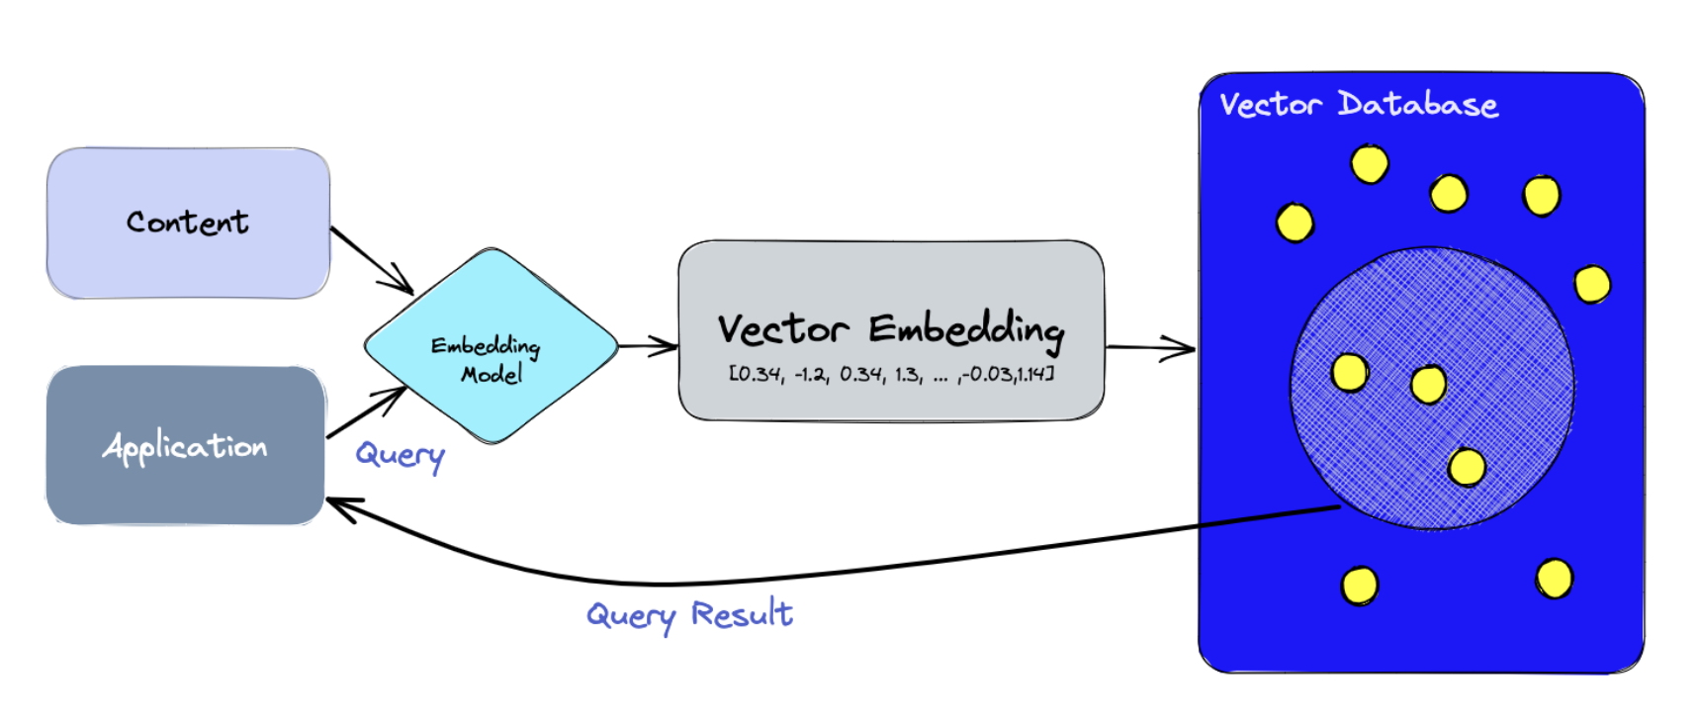
How do VectorDBs work?
We use the embedding model to create vector embeddings for the content we want to index.
The vector embedding is inserted into the vector database, with some reference to the original content the embedding was created from.
When the application issues a query, we use the same embedding model to create embeddings for the query, and use those embeddings to query the database for similar vector embeddings. And as mentioned before, those similar embeddings are associated with the original content that was used to create them
Image from https://www.pinecone.io/learn/vector-database

Slide 5
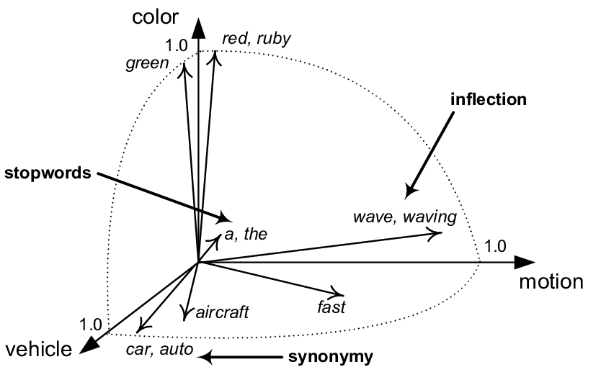
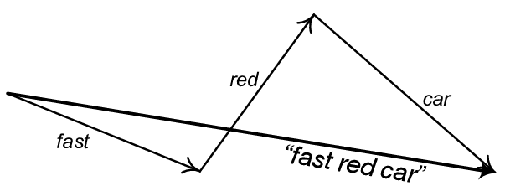
Vectors in Language Models
Image from https://www.researchgate.net/figure/TVSM-document-model-visualization_fig1_298215705

Slide 6
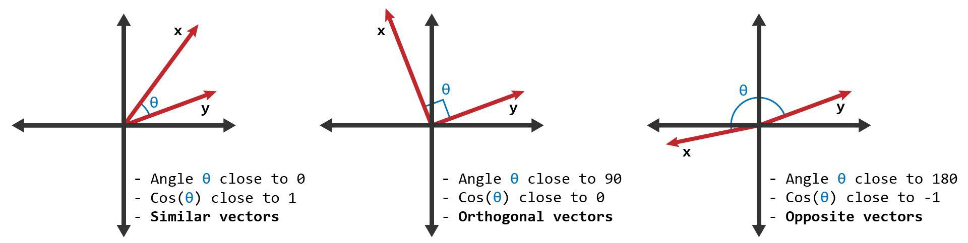
Similarity Metrics
Cosine Similarity

Slide 7





Use Case: Document(s) Querying
Text Chunks
Vector Database
Insert
Splitting
Embeddings
Extract Text
Search
Relevant chunks
Query
Predefined prompt + Relevant Chunks + Query
Gives a response

Slide 8


Other use cases:
Facial Recognition
Vector Database
Insert (embeddings + reference)
User1 face
Embeddings (FaceNet-style network)
Search by cosine similarity. Set a threshold > 0.97
Query
Yes, one vector found with similarity = 0.98. It corresponds to User1
Any vectors with similarity above threshold?
Image created with Stable Diffusion + ControlNet: “a man with fashionable glasses”

Slide 9





Other use cases:
Image Search
Vector Database
Insert (embeddings + reference)
Embeddings (CLIP or ImageNet model)
Search by cosine similarity. threshold > 0.98, top n=2
Query
“Find similar images to this one”
Any vectors with similarity above threshold?
Top n images with cosine similarity > 0.98.
All Images created with Midjourney

Slide 10


Thanks
https://github.com/elcronos/ChatDocuments
https://www.linkedin.com/in/camilopestana/

